Slide 1
Pitch -
New technology, new lifestyle…
Presenter: Caroline Jin

Slide 2
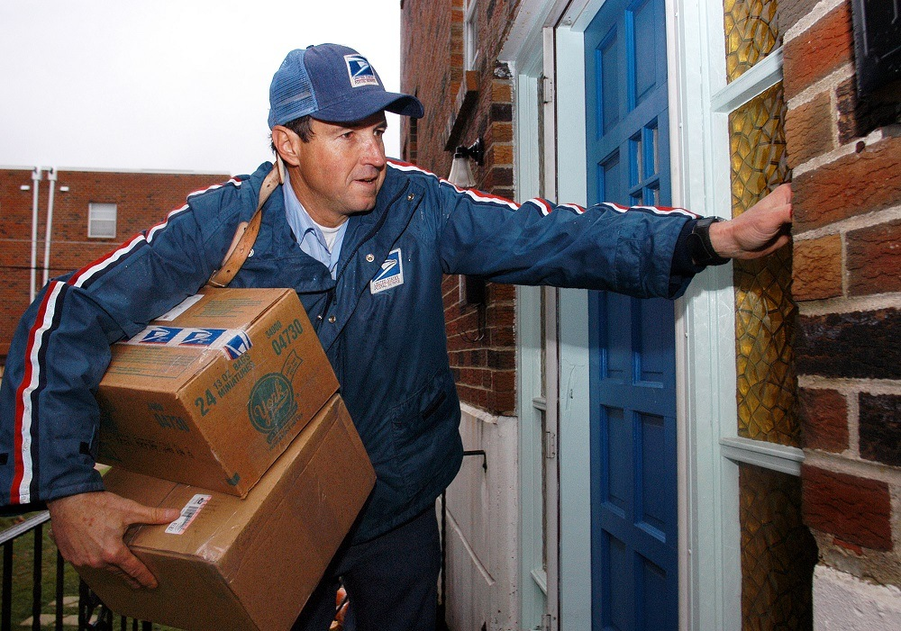
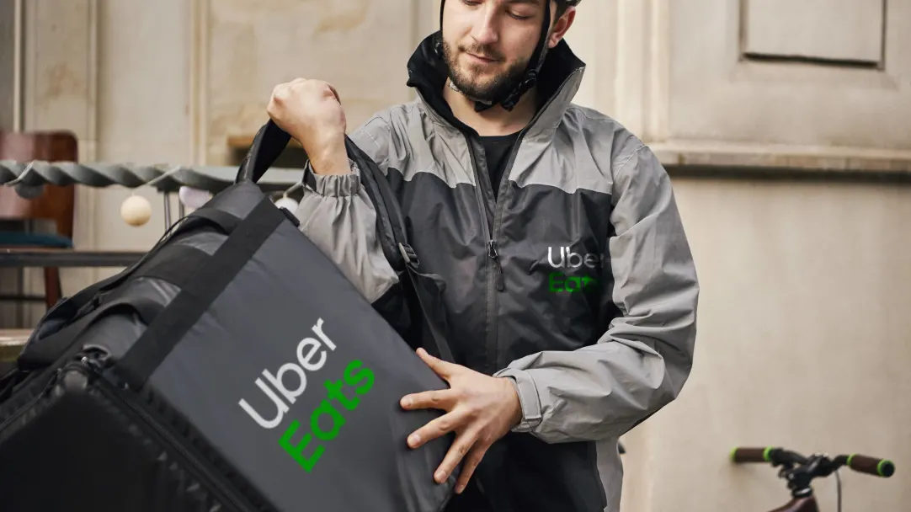
Traditional delivery methods
Tired of spending hours on waiting for ubereats?
Always lose your packages because of the poor delivery services?
Unable to get life essentials during city lock-down?

Slide 3
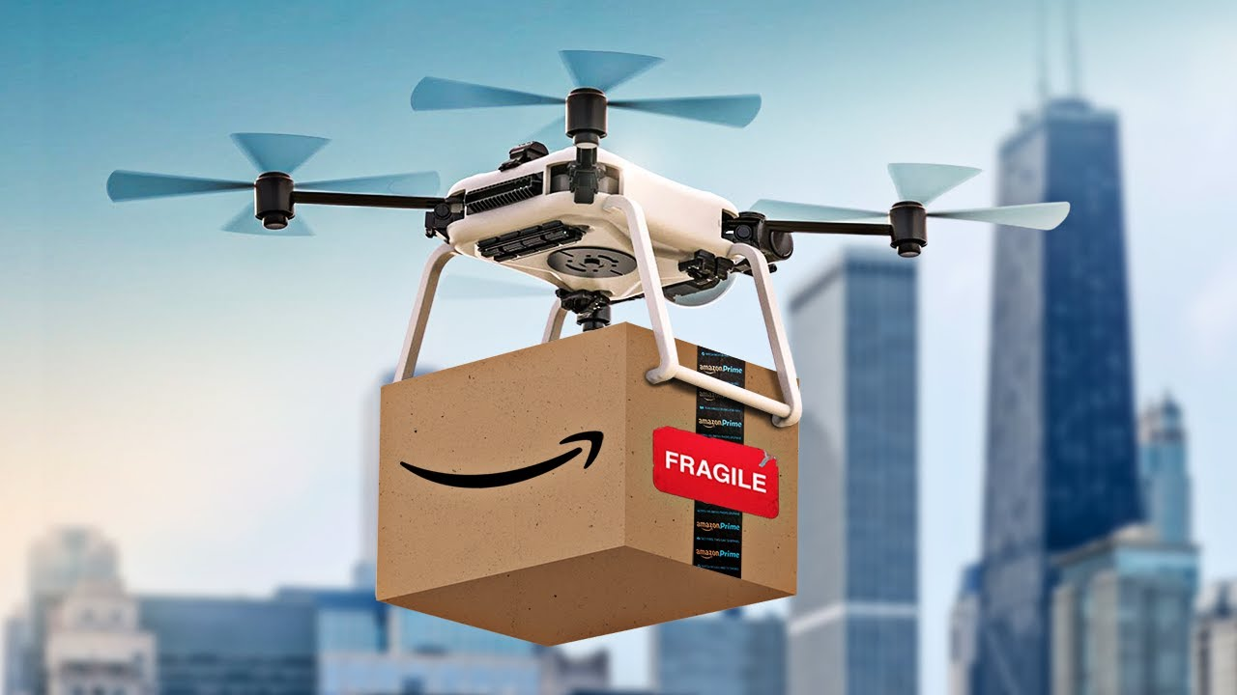
Introducing the new technology that changes your life
DRONES! Yes, using drones to do the delivery.
Saves more time
Less contact, less risks of getting the covid.
Won’t be affected by the city lock-down.

